Slide 1
10

Slide 2
9

Slide 3
8

Slide 4
7

Slide 5
6

Slide 6
5

Slide 7
4

Slide 8
3

Slide 9
2

Slide 10
1

Slide 11
0

Slide 12
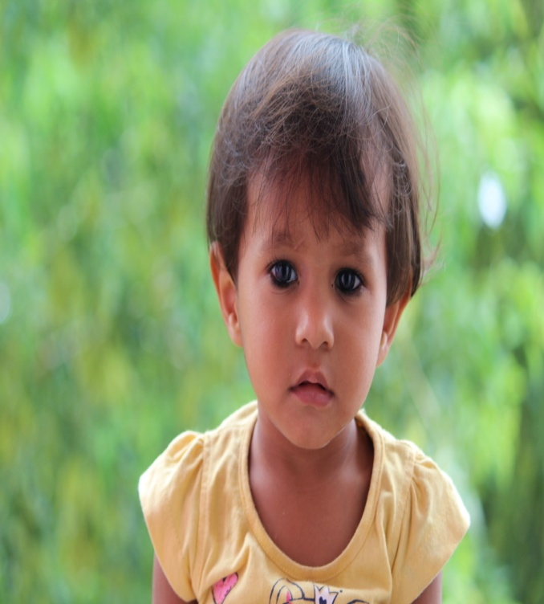
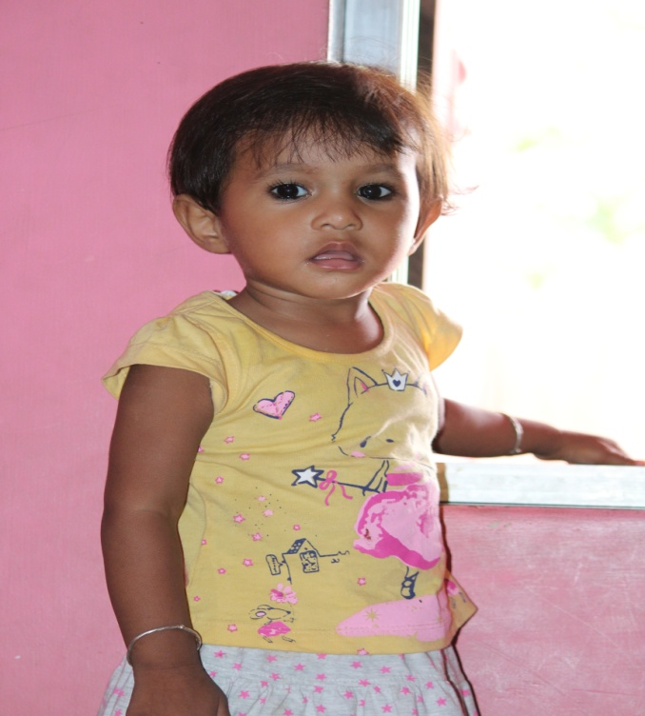
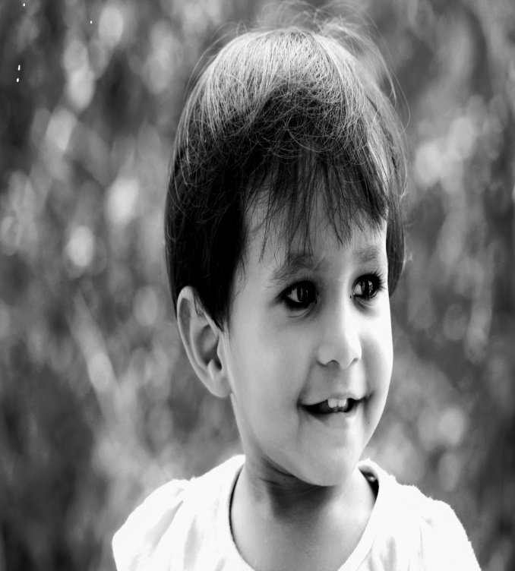
KHUSHI
KRISHNA
KHUSHI
KRISHNA
KHUSHI
KRISHNA

